Slide 1
Scientific Machine Learning for Modeling, Optimization, and Control
Ján Drgoňa
incoming associate professor @ CaSE & ROSEI

Slide 2


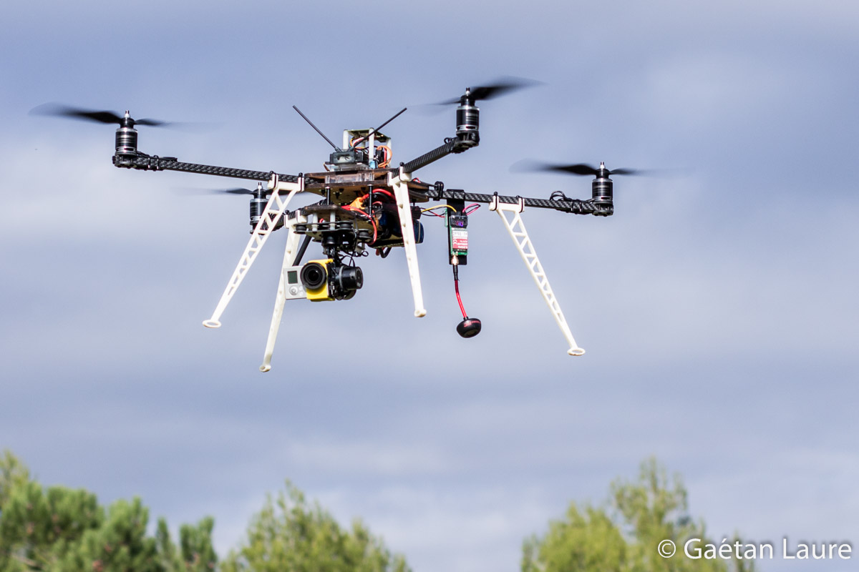
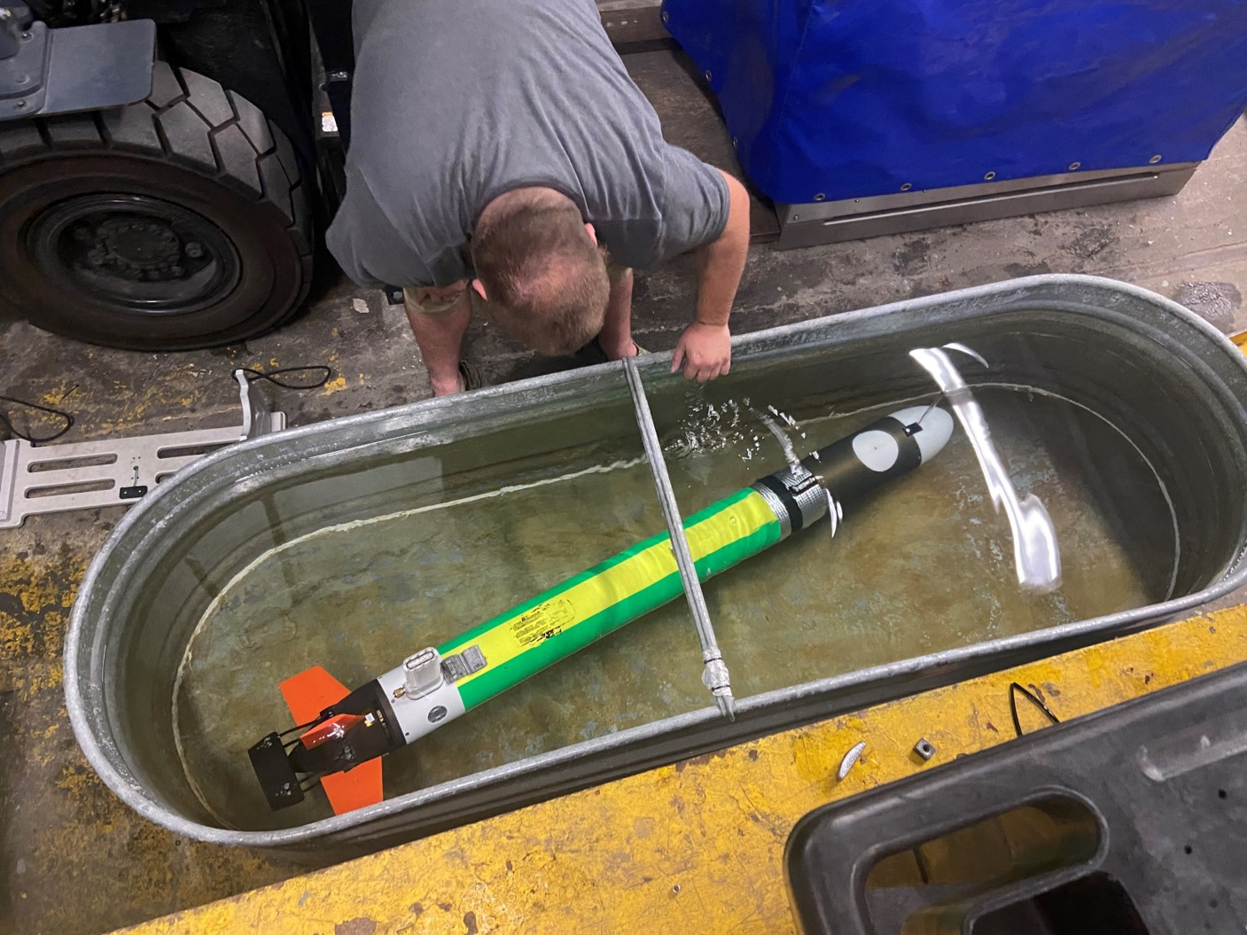
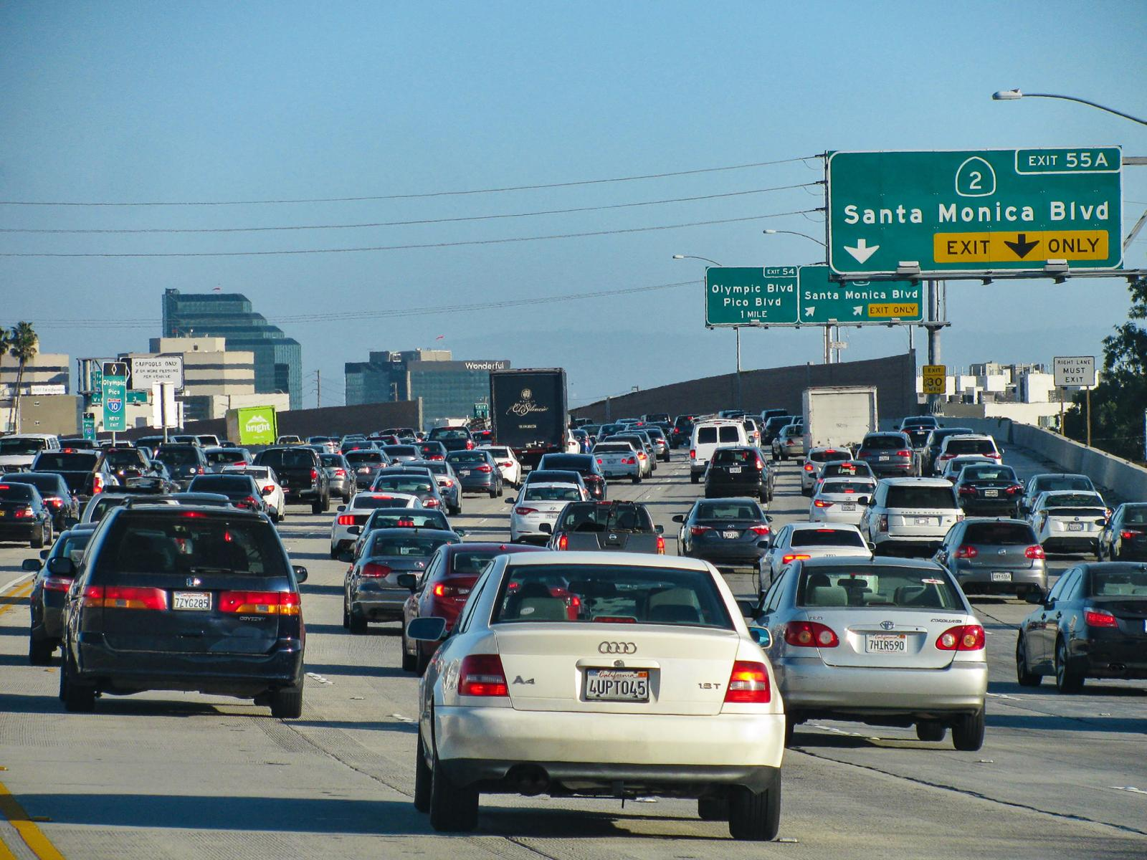
Motivation
Simulations are crucial for many areas of decision-making and scientific discovery
Need: Improve computational efficiency and scalability for heterogenous scientific simulations
Challenges:
Modeling and simulation of complex systems is hard
Optimal control and closed-loop decision-making for complex systems is hard-er
Scientific computing and machine learning tools are fragmented and not easily composable

Slide 3
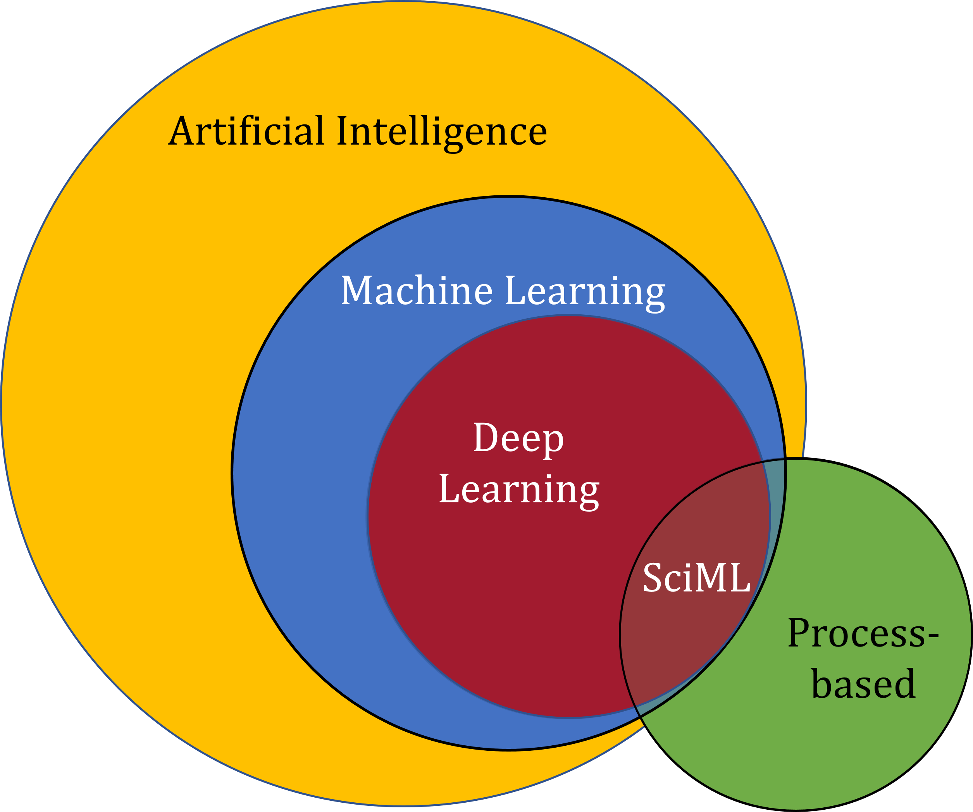
Scientific Machine Learning (SciML)
What?
SciML systematically integrates ML methods with mathematical models and algorithms developed in various scientific and engineering domains
Why?
Scientific applications are governed by fundamental principles and physical constraints
Purely data-driven “black box” ML methods cannot satisfy underlying physics
How?
Leverage automatic differentiation used in learning for modeling, optimization, and control
Karniadakis, G.E., Kevrekidis, I.G., Lu, L. et al. Physics-informed machine learning. Nat Rev Phys 3, 422–440, 2021.
Image source: https://sciml.wur.nl/reviews/sciml/sciml.html

Slide 4
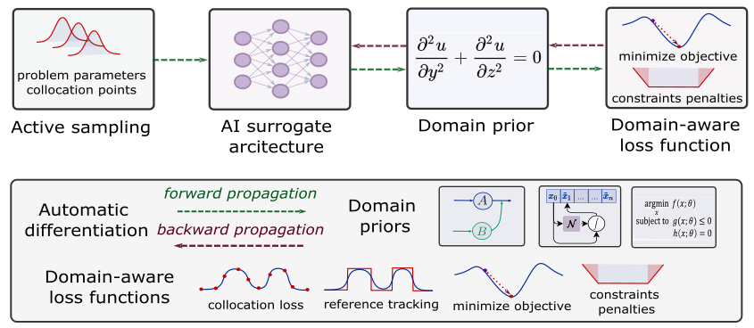
Landscape of Scientific Machine Learning Methods
Karniadakis, G.E., Kevrekidis, I.G., Lu, L. et al. Physics-informed machine learning. Nat Rev Phys 3, 2021.
Thiyagalingam, J., Shankar, M., Fox, G. et al. Scientific machine learning benchmarks. Nature Reviews Physics 4, 413–420, 2022.
Nghiem T., Drgona J., et al. Physics-Informed Machine Learning for Modeling and Control of Dynamical Systems, ACC, 2023.

Slide 5

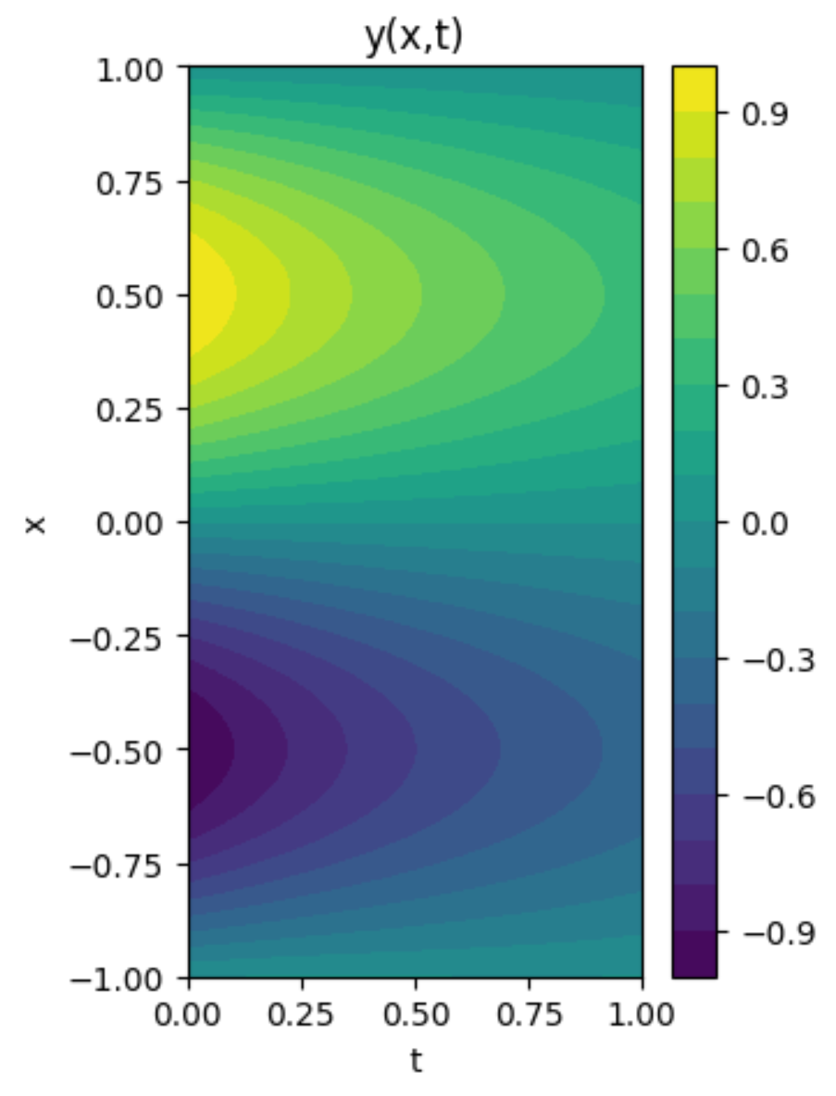
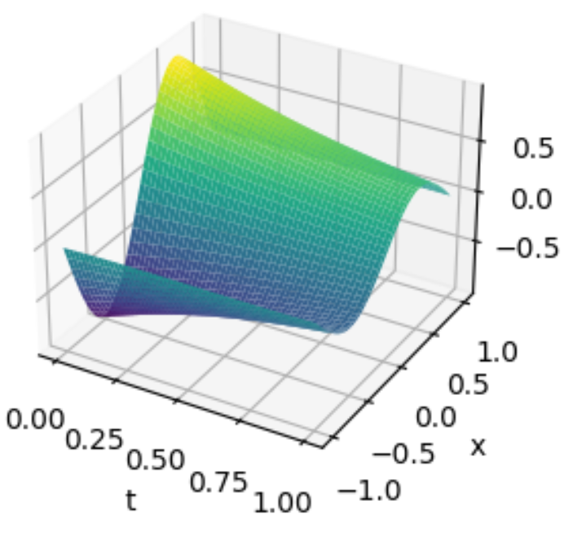
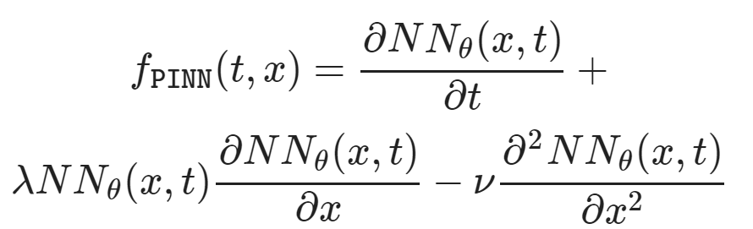
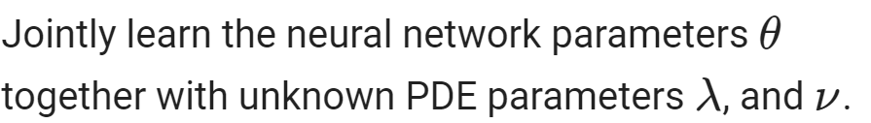
Learning to Solve Differential Equations with Physics-Informed Neural Networks (PINNs)
Training neural networks as PDE solutions
Parameter estimation from data (inverse modeling)

Slide 6
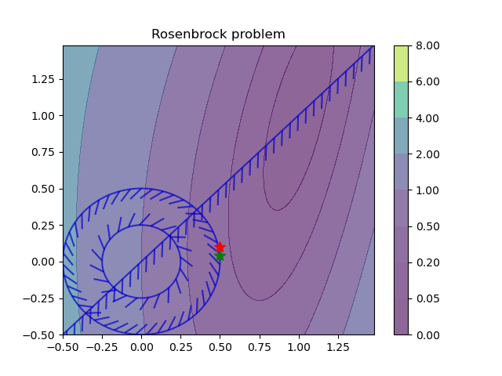
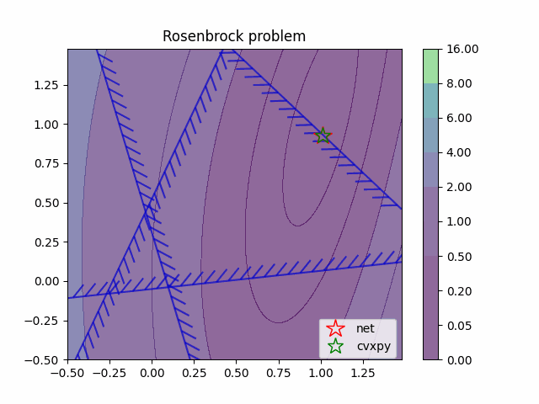
Learning to Optimize (L2O) with Constraints
Training neural networks as parametric solutions
Feasibility restoration with optimization layers

Slide 7
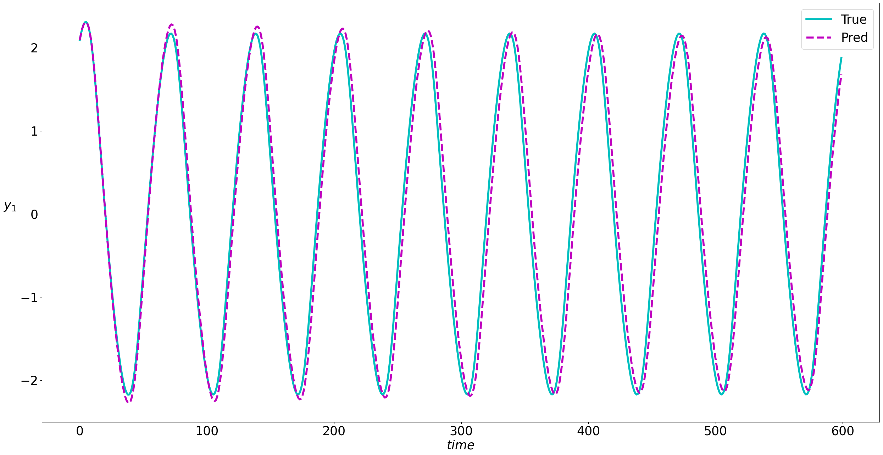
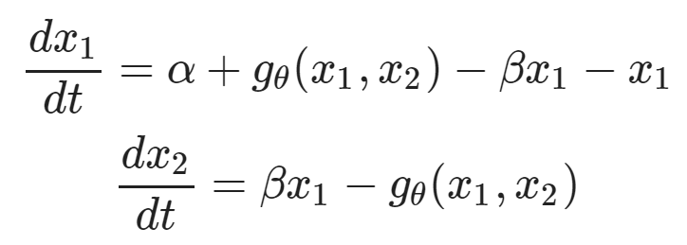
Learning to Model (L2M) with Neural Operators
Neural models for nonlinear system identification
Gray-box parameter estimation
C. Rackauckas, et al., Universal Differential Equations for Scientific Machine Learning, 2021

Slide 8
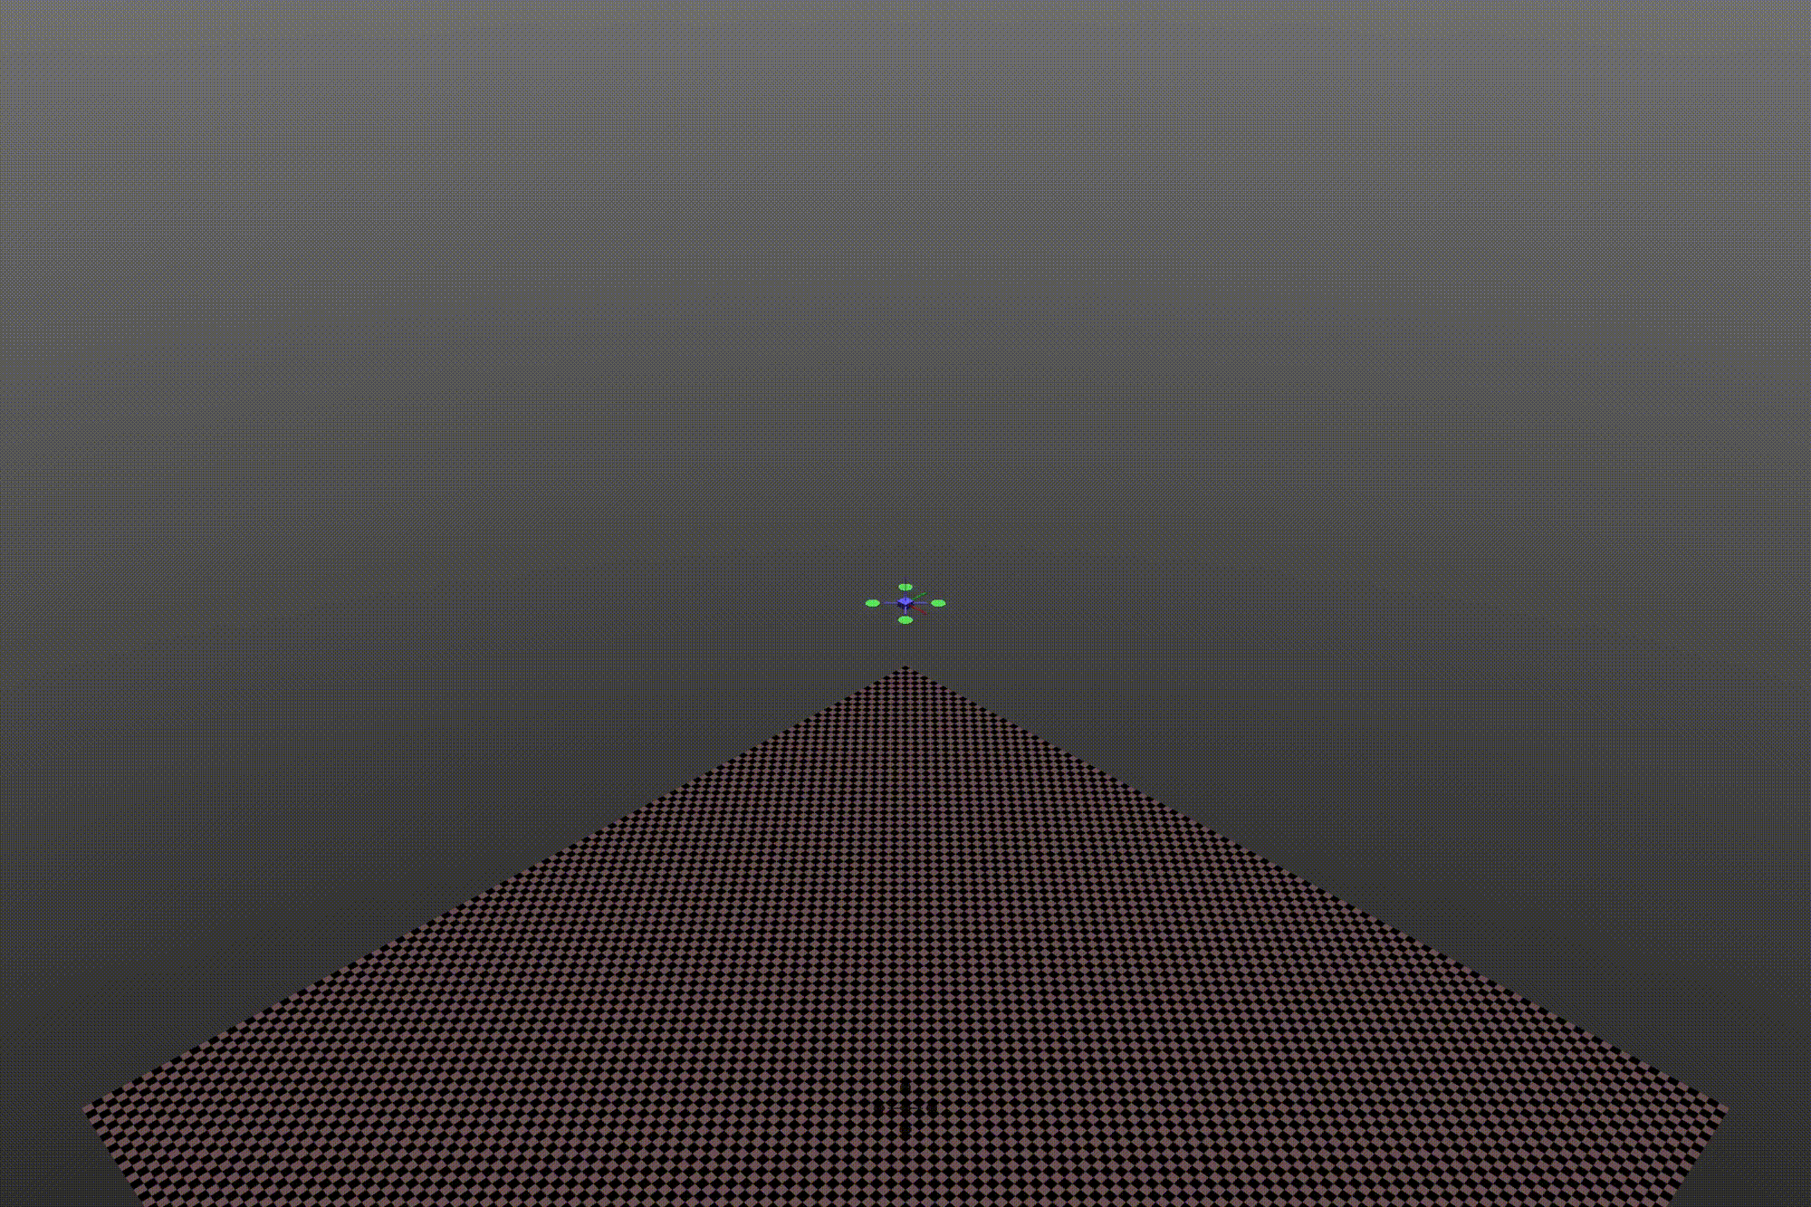
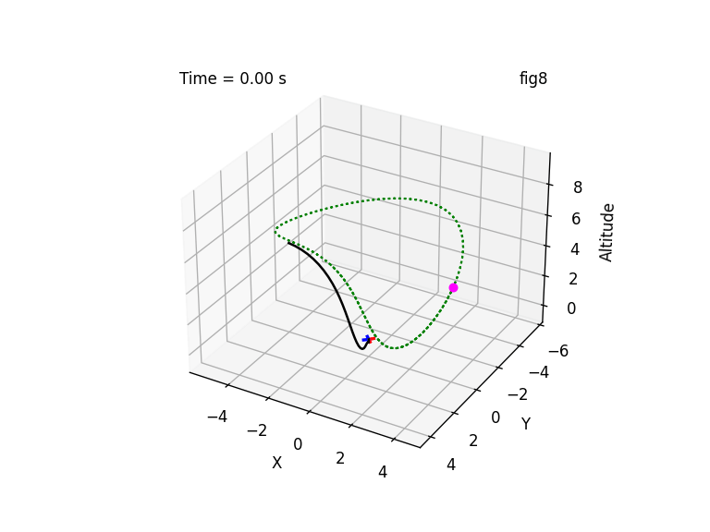
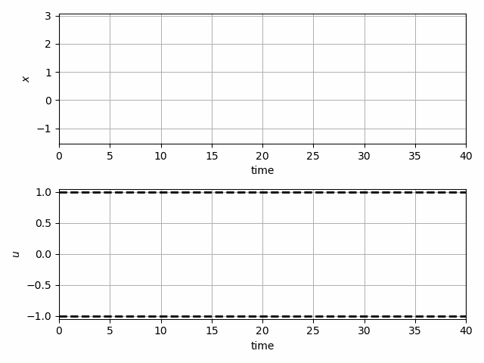
Learning to Control (L2C) with Differentiable System Models
Trajectory optimization for dynamical systems
Learning stabilizing controllers

Slide 9
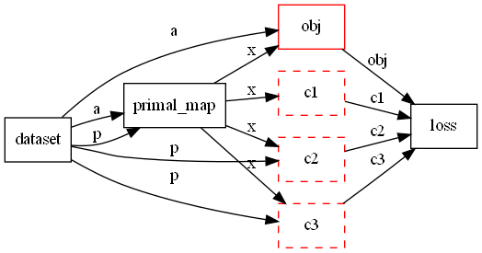
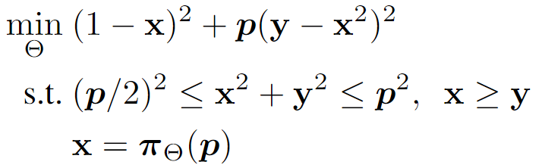

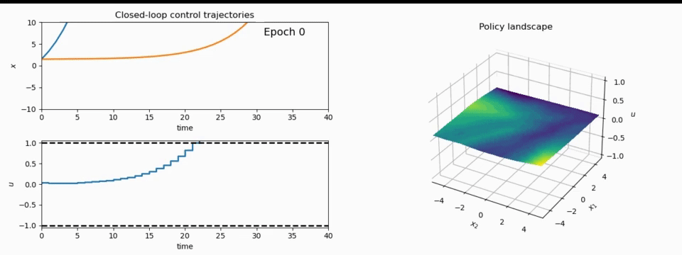
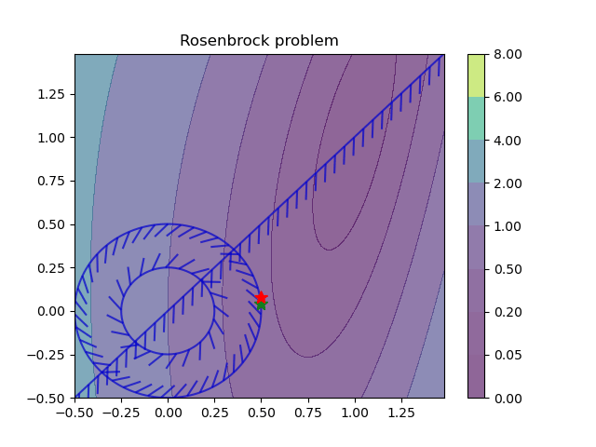
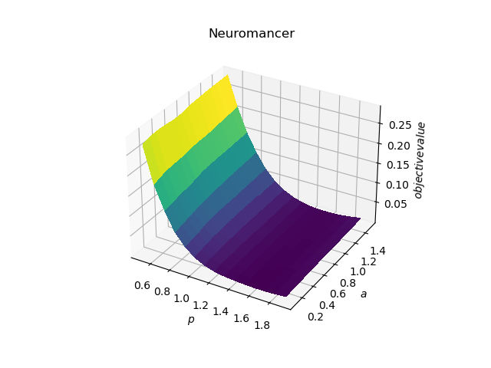
NeuroMANCER Scientific Machine Learning Library
1. Mathematical formulation
3. Problem graph
map
2. Python code interface
4. Results
import neuromancer as nm
p = nm.variable(‘p’)
x = nm.variable(‘x’)
y = nm.variable('y’)
obj = ((1-x)**2 + p*(y-x**2)**2).minimize(weight=1.0, name='obj’) c1 = (p/2)**2 <= x**2 + y**2
c2 = x**2 + y**2 <= p**2
c3 = x >= y net = nm.MLP(insize=2, outsize=2, hsizes=[80]*4) map = nm.Node(net, input_keys=['p’], output_keys=[‘x’,‘y’])
loss = nm.PenaltyLoss([obj], [c1, c2, c3]) problem = nm.Problem([map], loss)
optimizer = torch.optim.AdamW(problem.parameters()) trainer = nm.Trainer(problem,data,optimizer)
best_model = trainer.train()

Slide 10



Summary
Scientific machine learning (SciML) methods integrating deep learning, constrained optimization, physics-based modeling, and control in a coherent framework
Learning to optimize (L2O)
Learning to control (L2C)
Learning to model (L2M)
Learning to solve (L2S)
github.com/pnnl/neuromancer
www.youtube.com/@neuromancer_SciML
drgona.github.io

